Slide 1
Project Updates
AI Enabled Nova Chat
Revolutionizing Lab operations
Srikanth Aakuthota
Sep 2023, Bangalore

Slide 2
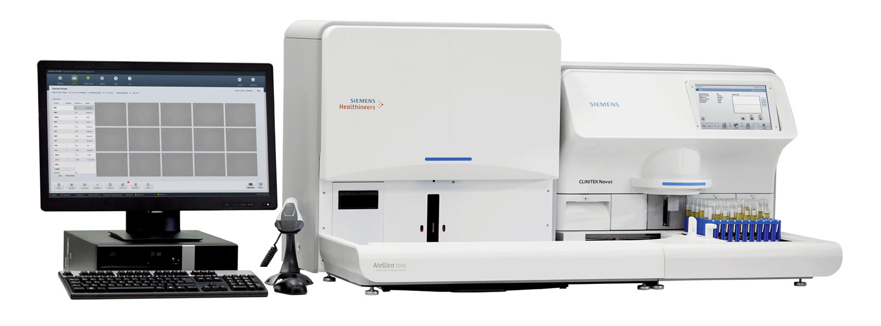
POC
Centralized
Urinalysis
Author | Department

Slide 3
Novus Refresh
Hardware Changes
Software Changes
Author | Department

Slide 4

Atellica 1500 on Automation Track
Srikanth Aakuthota
Restricted © Siemens Healthineers, 2019

Slide 5
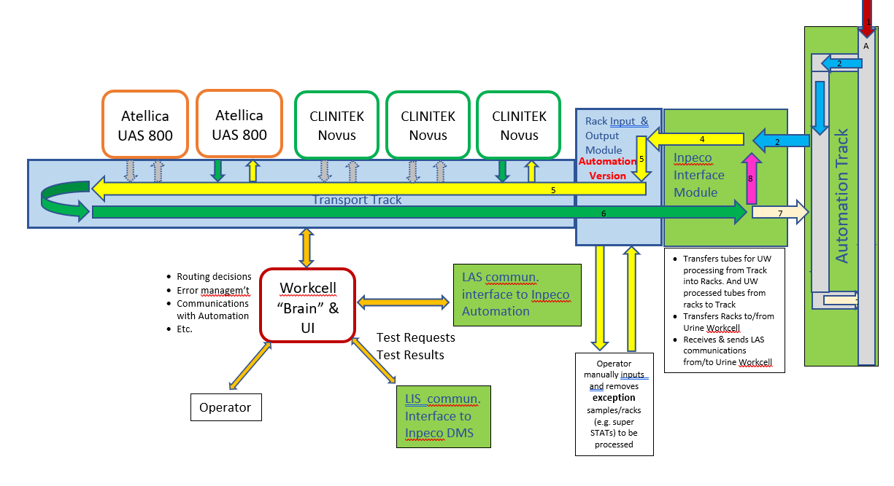
Atellica 1500 on Automation Track

Slide 6
Rack orientation
Novus Rack orientation will be the same in the 800.
From 77e side :
they will make the pipetting arm of the 800 longer so the pipette will be outside the 800.
And the rack mechanism inside the 800 would be obsolete (cost down).
From our side
Since the orientation of the rack would be the same as in the Novus we will need to change the RH (Rack Handler) design.
It will allow us to have :
a better workflow (without the need for rotation )
plan for the cascaded solution in a better way and in the future automation connectivity as well
Item cost will be lower them the current one.

Slide 7
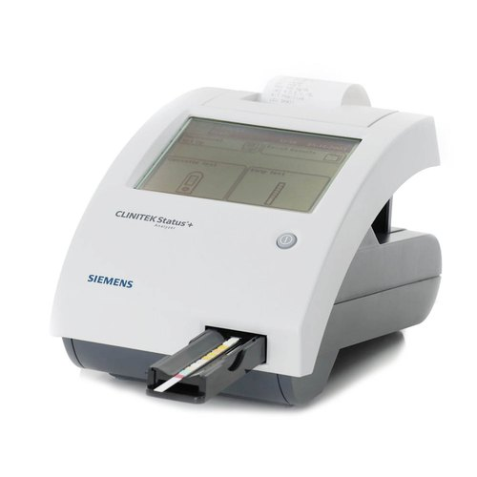
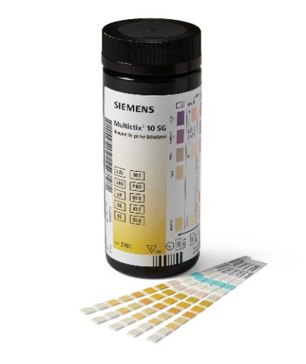
POC
Decentralized
Urinalysis
Author | Department

Slide 8







Why the CLINITEK Status Connect Wins
 | Siemens CLINITEK Status Connect* | Roche URISYS 1100 | Acon MISSION U120 | Acon MISSION U120 ULTRA | DTG CLARITY UROCHECK 120 | YD Diag URISCAN OPTIMA II | Analyticon URILYZER 100 Pro
Touchscreen
Menu: Routine, Kidney Disease, hCG
Automatic calibration
Auto-checks
Lot/Expiration entry/Tracking
Operator management/Lockout
Bar code
Patient result storage >700
Onboard storage of quality control results
Data management software interfaces
Bidirectional capability
HL7, POCT1A, ASTM
Wireless capability
= No functionality available = Partial functionality available = Full functionality available
*CLINITEK Status Connect System does not support ASTM.

Slide 9

Core Qualifications
I am an accomplished Technical Team Lead with over 14 years of experience in leading high-performing development teams.
Srikanth Aakuthota
SHS TE DC IND DX POC
R&D Engineering
• Architectural Designs: MVVM | MVC | Microservices
• Frameworks and Libraries: .NET Framework, .NET Core, Xamarin, Android, Angular, WinForms, WPF, UWP, EF, EF Core ADO.NET
• Programming Languages: C#, C++, LINQ
• Scripting Languages & Frameworks: JavaScript, jQuery, Angular , React, MEAN , MERN stack
• Web Technologies: ASP.NET MVC, ASP .NET CORE, WEB API
• Methodologies implemented in applications: Multi-Threading, Inter Process Communication, Synchronization of Threads and Processes using Semaphores, Mutex and SIGNALS, TCP/IP Communication (Server-Client Architecture), Serial Communication
• Software Design: OOPS | OOAD | UML
• Databases: MS SQL Server, SQLite
• IDEs and Debuggers: Visual Studio, SQL Server Management Studio, Visual Studio Code
• Operating Systems: Windows 10, Windows 7, IoT
• Industrial Protocols: ASTM, HL7, POCTA1
• Network and Application Protocols: FTP, SSH, HTTP/HTTPS, TCP/IP
• Communication skills, Problem-solving, cross functional management
Notes:
Add the photos of your teammates
Add the information of your teammates
Add the role during Hackathon of each teammate (e.g. Developer, Designer, Domain Expert, Project Manager…)

Slide 10
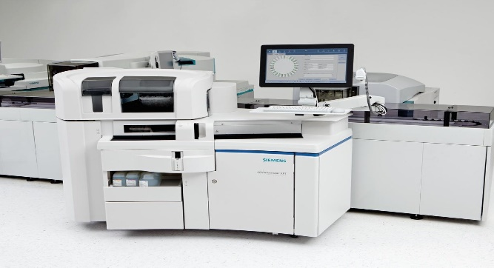
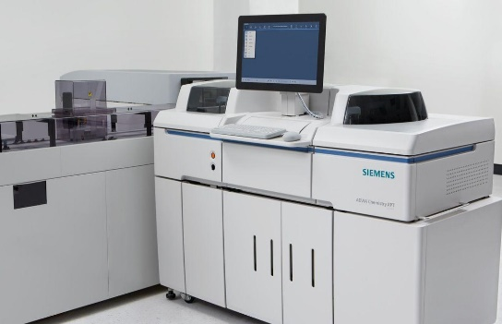
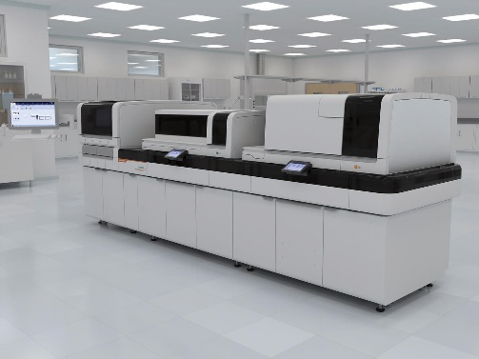

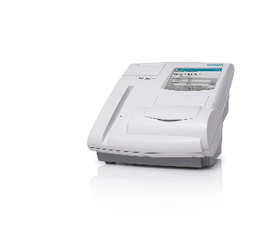
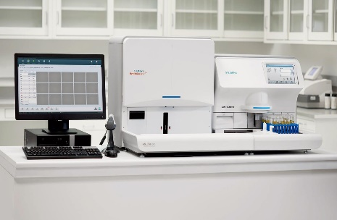
Product Experience
CLS Products
Chemistry and Immunoassay
Atellica solutions
POC Products
Atellica 1500 Urine Analyzer
CLINITEK Novus analyzer
DCA Vantage
Clinitek Status PLus

Slide 11
Product Contribution
Novus:
1.3.4
1.3.6
1.4
1.4.1 (On going)
DCA:
4.5
4.6
4.7
DCA Simulator
4.8 (On going)
Clinitek Status:
2.650(On going)
Lab Setups:
ACM
ADM
APM
POCCelarator
Feasibility studies:
Win10 IOT core
Linux migration
SRS connectivity to NOVUS
NOVUS UI migration to Angular

Slide 12
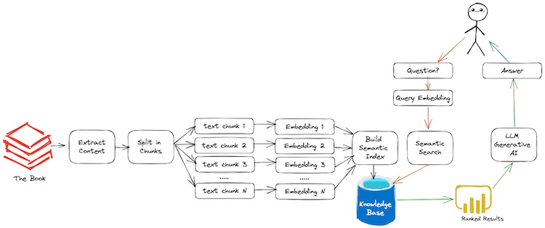
AI based OP guide

Slide 13
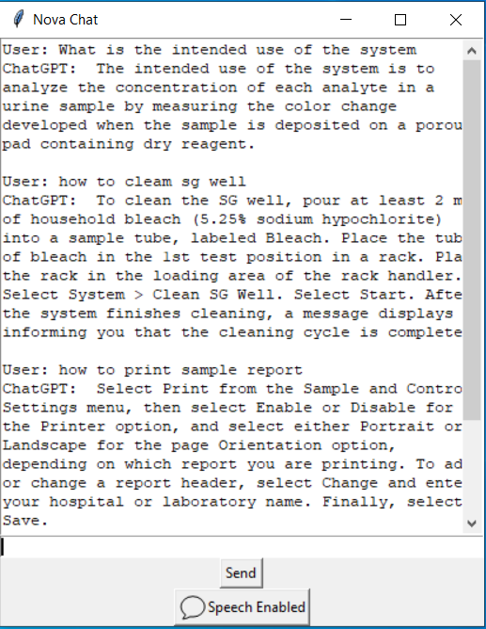
AI based OP guide

Slide 14
Proposal2: AI Enabled Mega lab management
Handling critical maintenance records
Lab internal communications (Between shifts)

Slide 15
Thank you.

